Slide 1

Notes:
In the past month, we’ve seen some incredible things

Slide 2
Basics
Notes:
we started from the basics of quantum computing

Slide 3
Basics
QBronze
Notes:
to obtaining the qbronze

Slide 4
Basics
QBronze
QSilver
Notes:
and QSilver certifications

Slide 5
Basics
QBronze
QSilver
Professionals
Notes:
as well as hearing from professionals from a lot of different areas of quantum

Slide 6
Basics
QBronze
QSilver
Professionals
Hardware
Notes:
and getting an overview of different kinds of quantum hardware

Slide 7

Dive deeper.
Notes:
now, it’s time to dive deeper

Slide 8

Introduction to Photonic Quantum Computers
QWorld Quantum Hardware Education Challenge
Womanium Global Quantum Hackathon 2022
Notes:
with our course on photonic quantum computers

Slide 9


QGirls
Temitope Adeniyi
Klára Churá
Deeksha Dadhich
Sofia d'Atri
Seyedeh Mahshad Hosseini
Notes:
my name is sofia d’atri, and with my team qgirls we created an innovative course to extend qworld’s curriculum and laid the basis for its future expansion

Slide 10
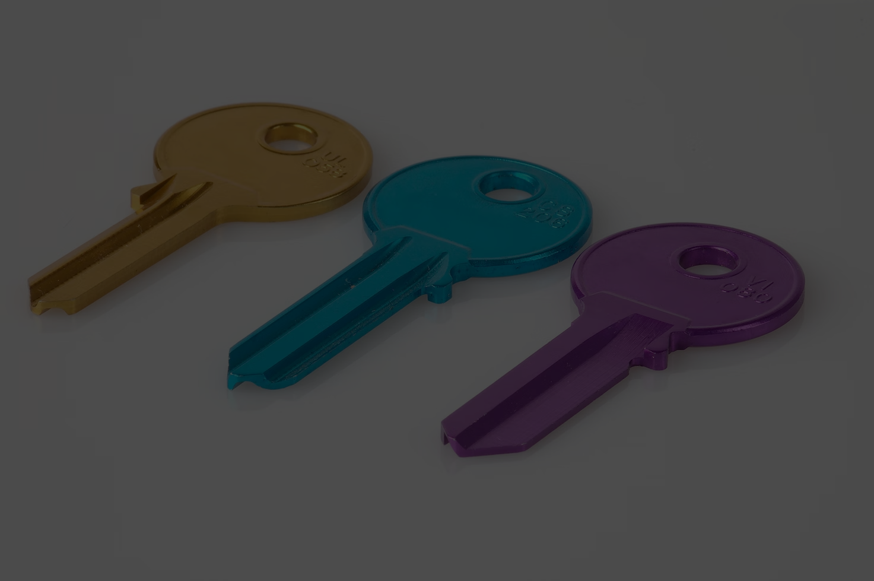
3 key areas
Notes:
our course is focused on 3 key areas

Slide 11
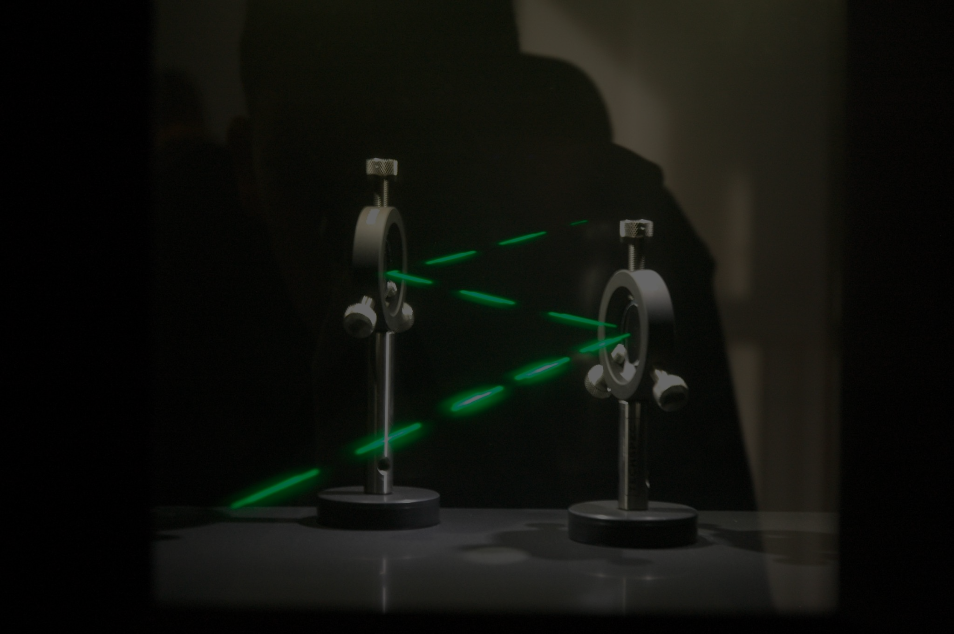
Hardware
Notes:
one, the hardware itself, with a focus on photonic integrated circuits

Slide 12
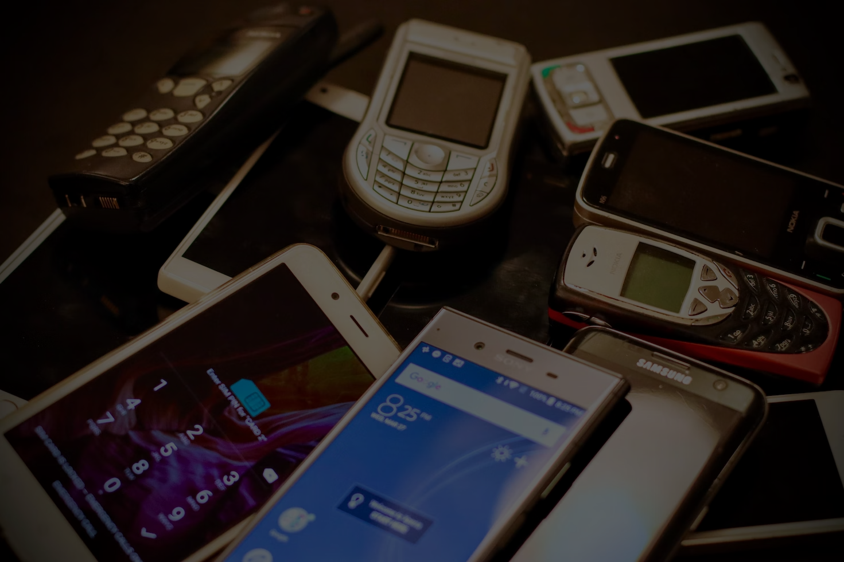
Applications
Notes:
two, the applications, such as the quantum key distribution protocol for secure communication

Slide 13

Industry
&
Academia
Notes:
last but not least, what the industry and academia look like for this field

Slide 14

Not
enough.
Notes:
however, just creating modules is not enough for us

Slide 15

One
step further
Notes:
we decided to take our course one step further

Slide 16
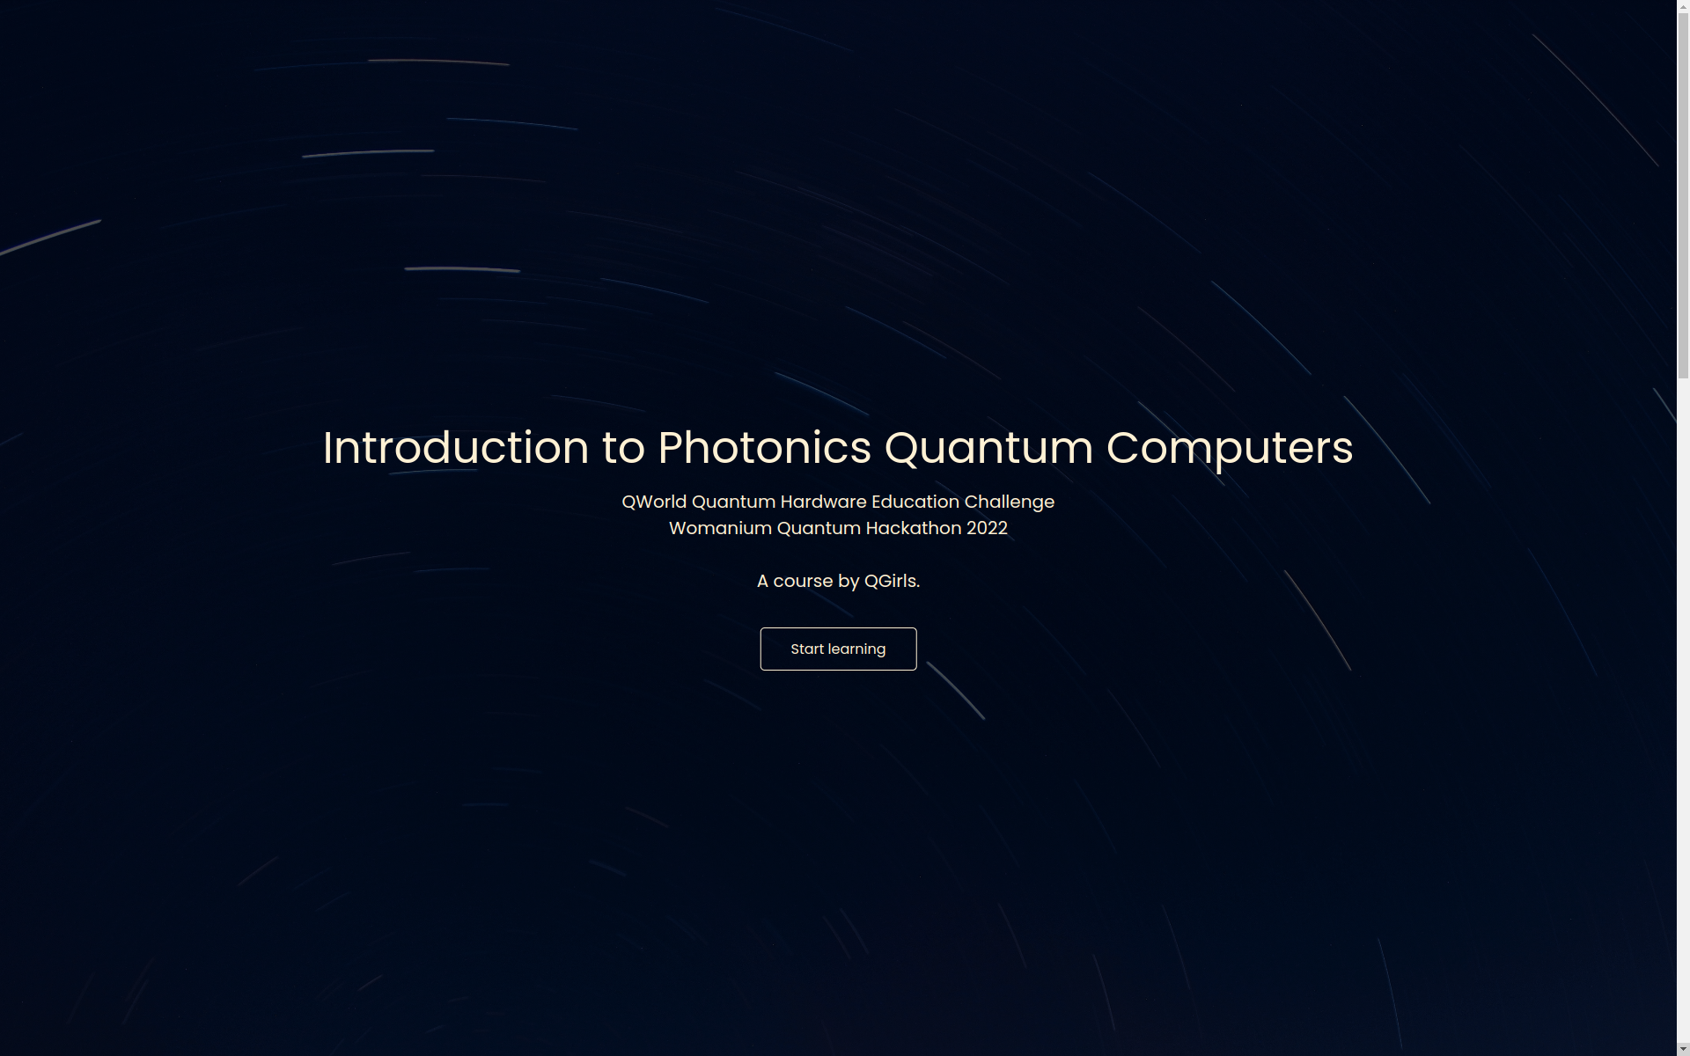
Notes:
so we created a website (this is the landing page)

Slide 17
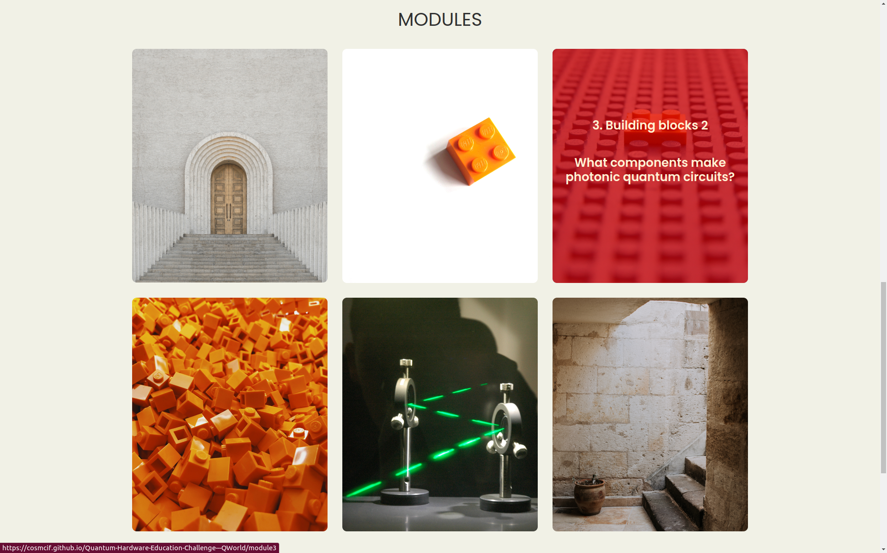
Notes:
to gather all of our materials

Slide 18
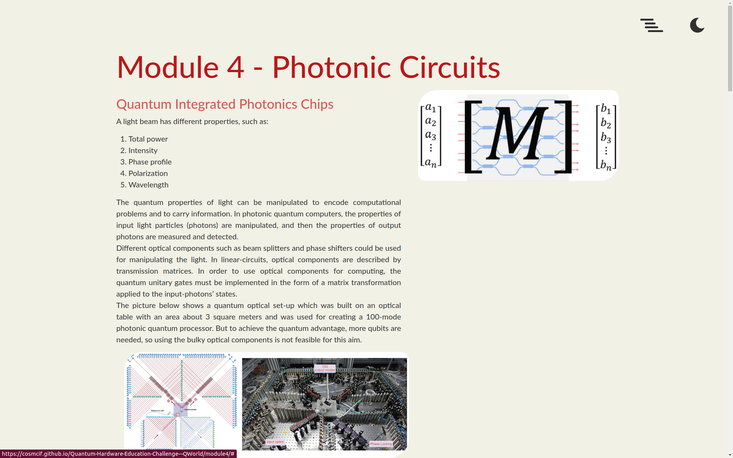
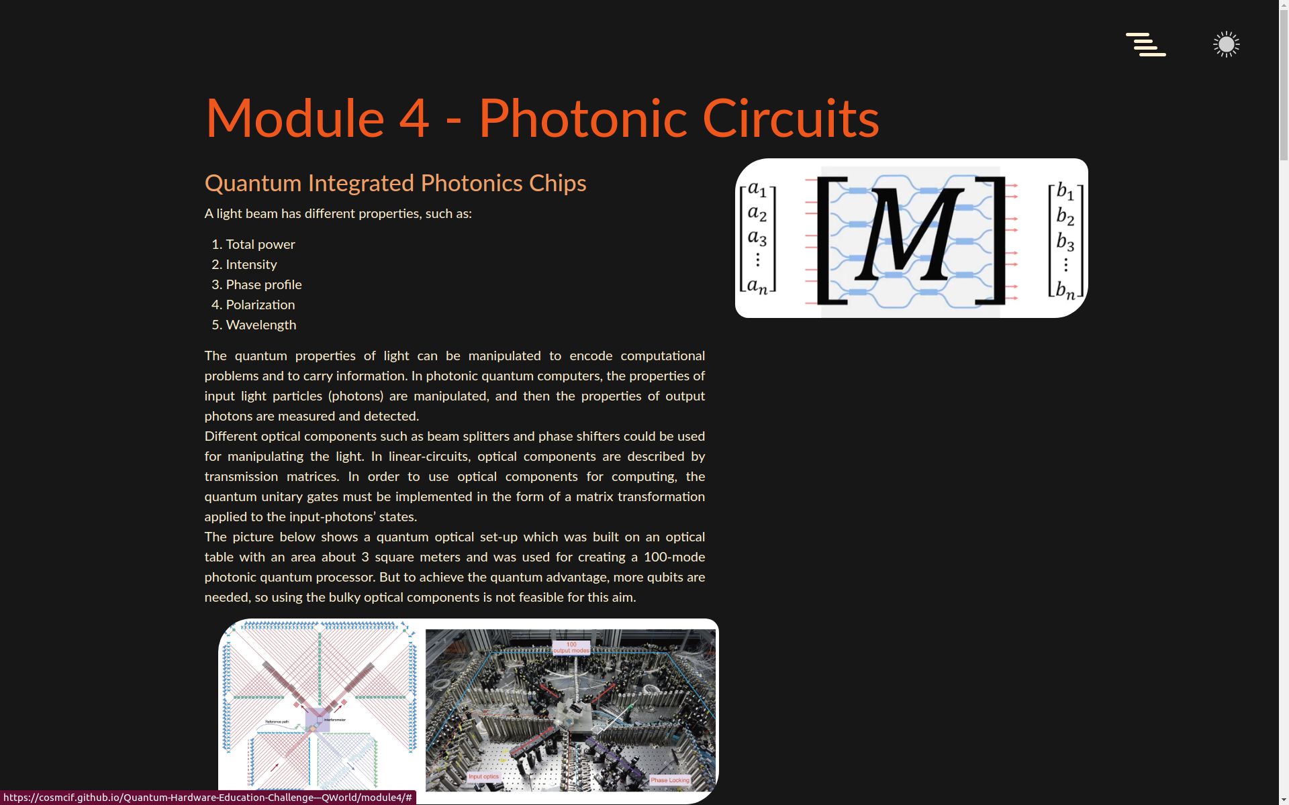
Notes:
with a light and dark mode

Slide 19
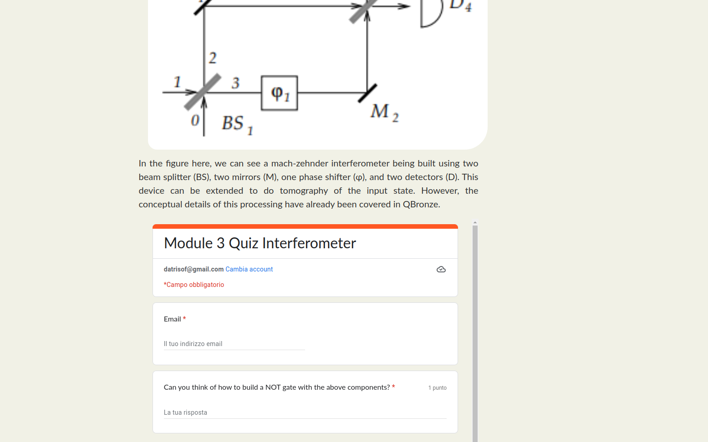
Notes:
and interactive modules with quizzes to test your knowledge as you go

Slide 20
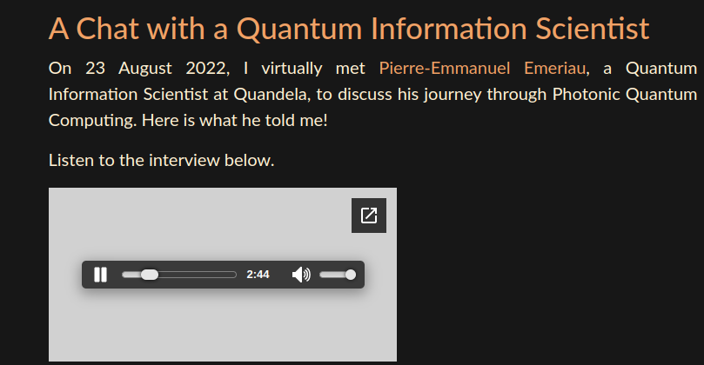
Notes:
as well as exclusive content such as interviews

Slide 21
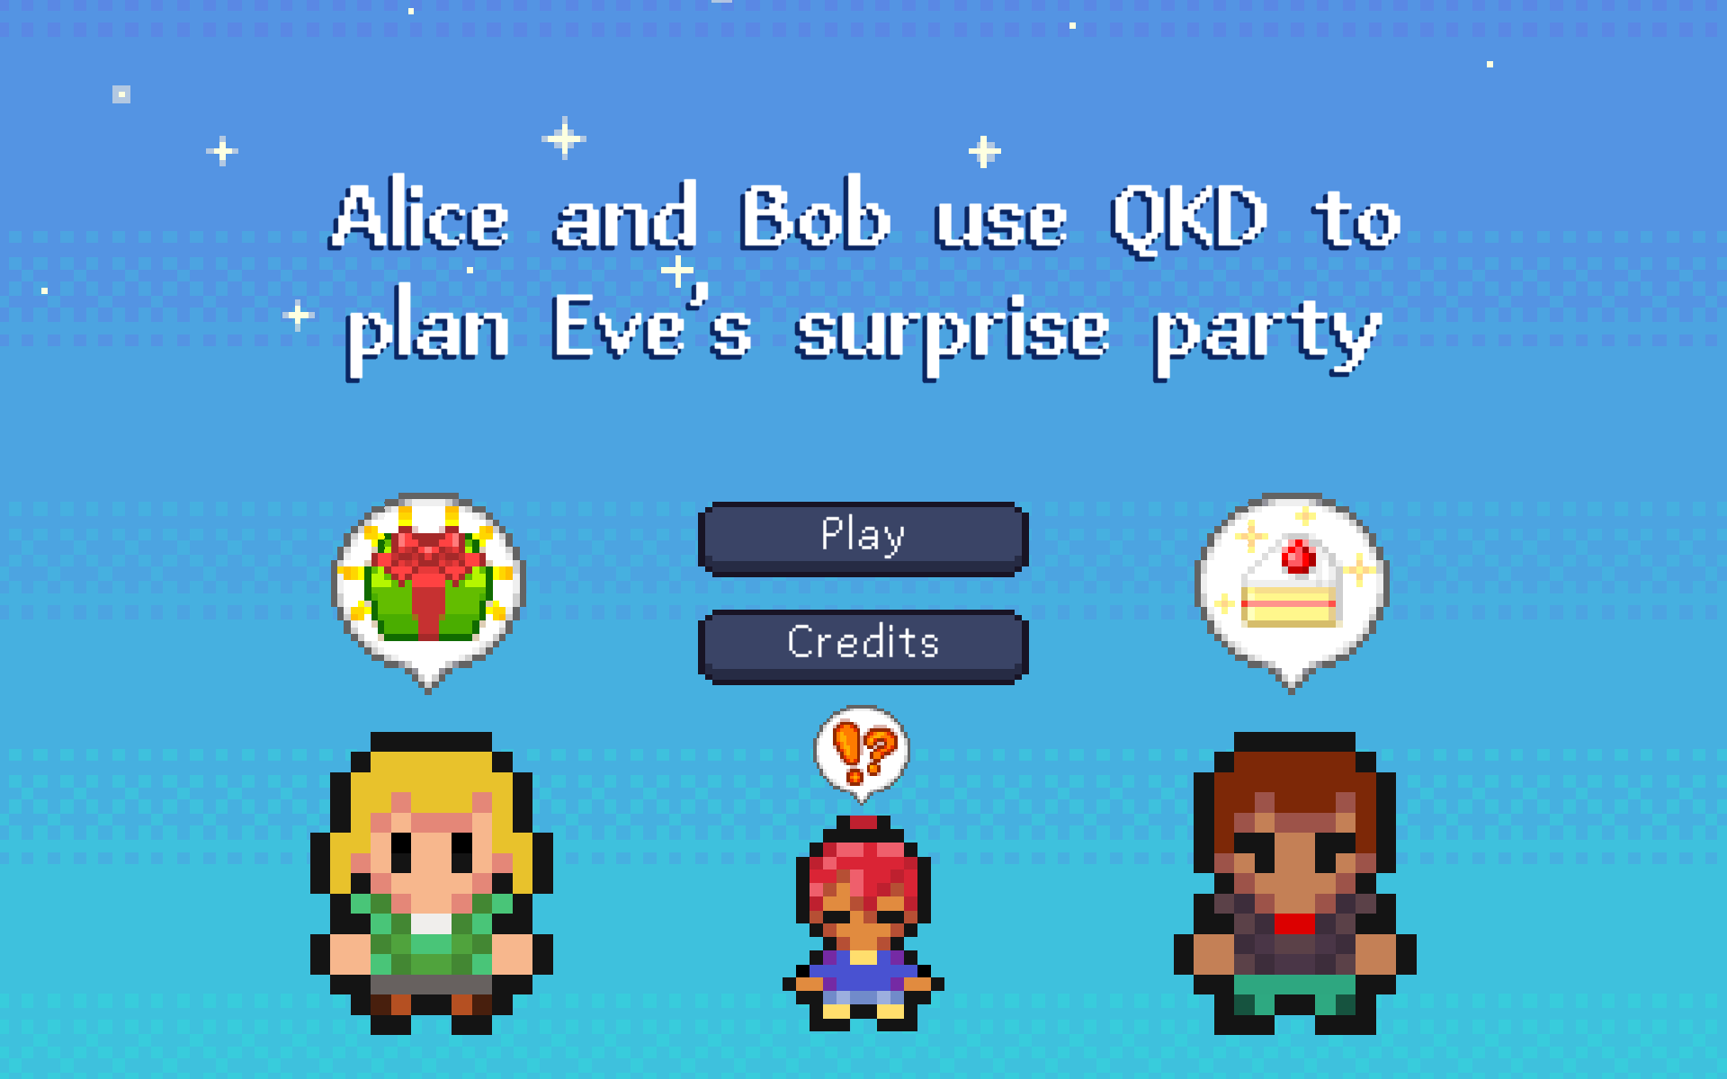
Notes:
and even videogames!

Slide 22
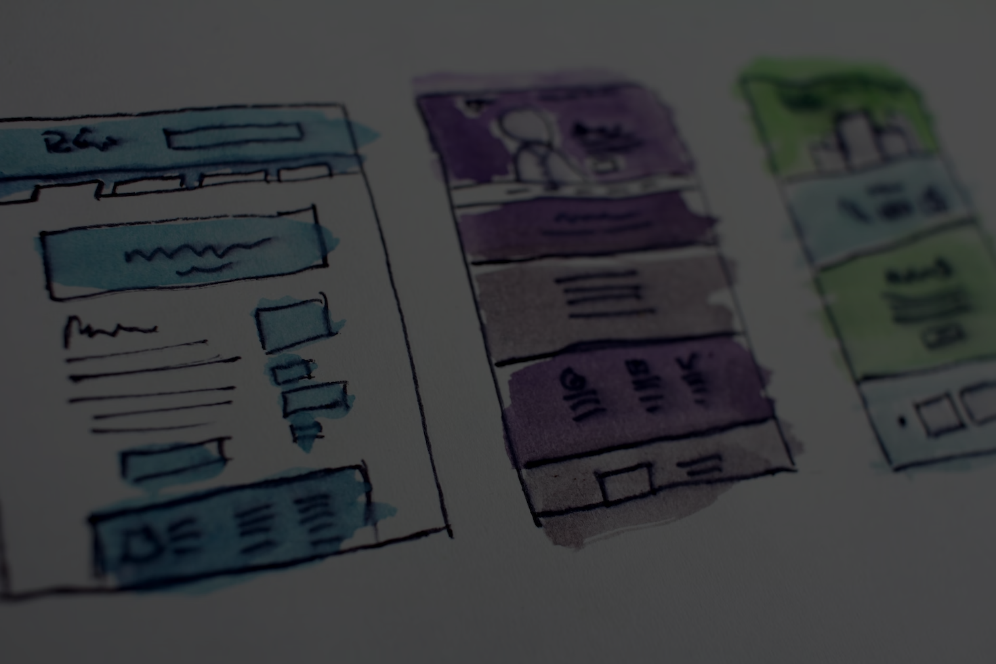
Easy to access
Notes:
thanks to the website, our course and all its contents are easy to access

Slide 23
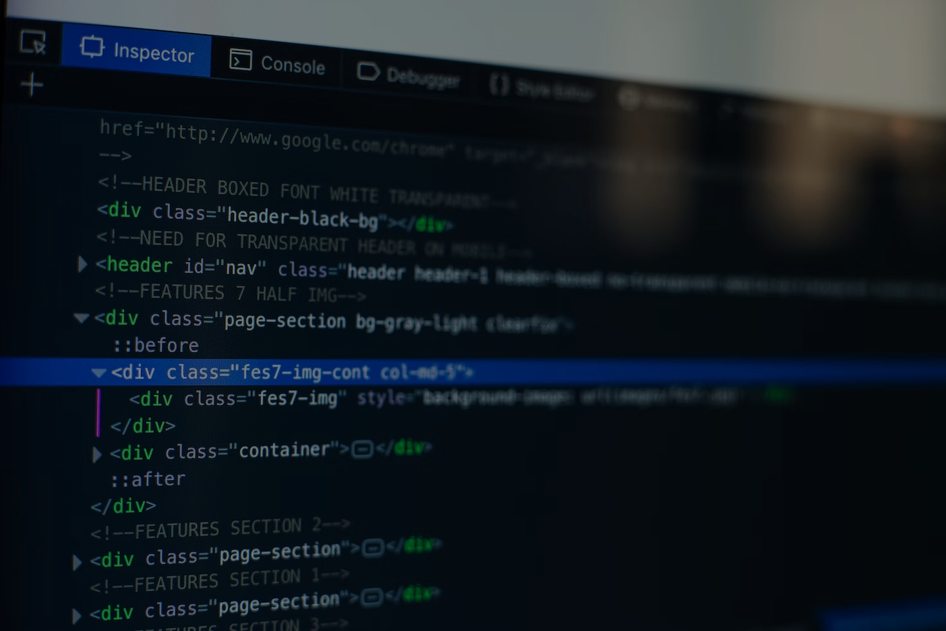
Easy to expand
Notes:
while the course itself can be easily expanded to add more modules and activities

Slide 24
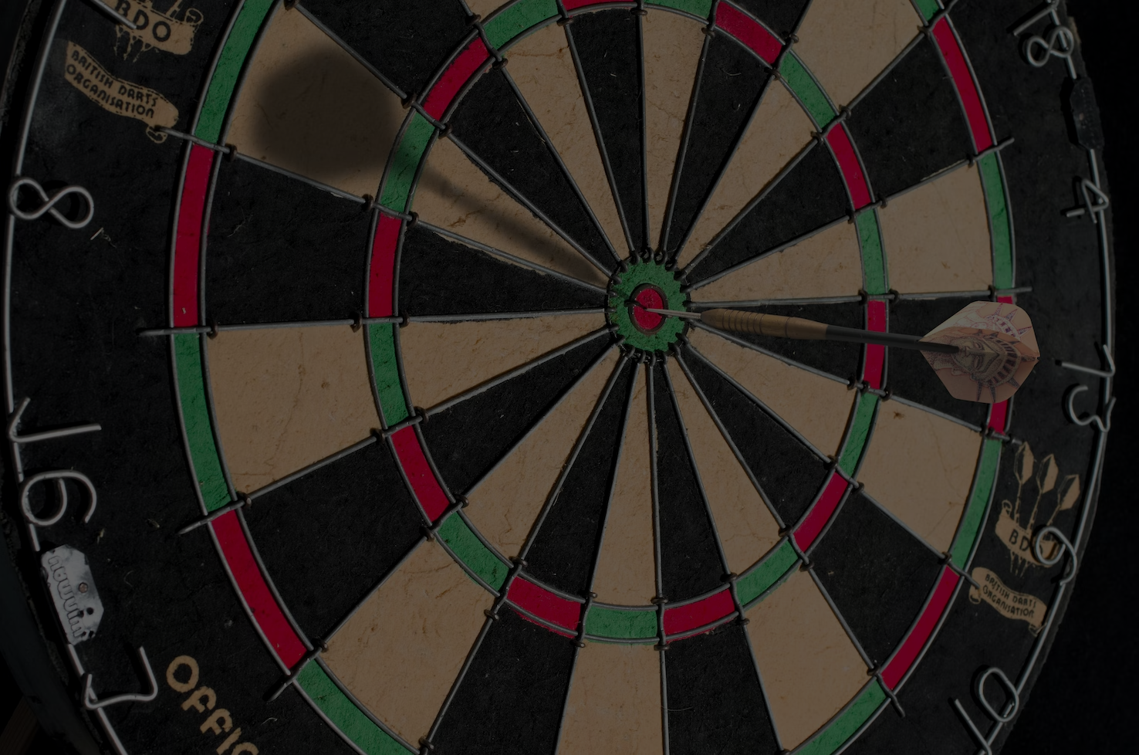
Goals
Notes:
on that note, we have some goals for the future of this project, even after the hackathon has ended

Slide 25

Modules
Exercises
Activities
Notes:
such as adding more modules, exercises, interactive activities

Slide 26

Community
Notes:
but the most important to us, is the creation of a community, people at any level of their studies or careers who want to learn more and support each other in this photonic journey

Slide 27
Notes:
a journey that begins here.

